Slide 1

Final Project
Erica Volden
Data Mining (DS 260)

Slide 2

Introduction
Features
Temperature:
Room heated above 19 C
Data readings taken with door open/closed
Humidity:
Humidity levels in the room
Light:
Light levels in the room
CO2:
Level of carbon dioxide in the room
Humidity Ratio:
The content of water vapor in the air
Occupied:
Target variable being predicted
Digital camera to monitor if room occupied
1 for yes
0 for no

Slide 3

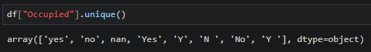
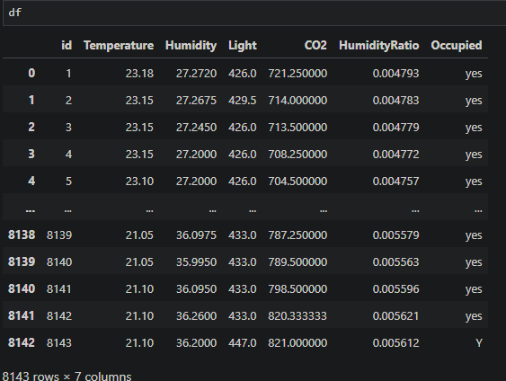
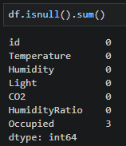
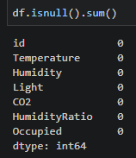
Data Preparation
df.dropna(axis=0, inplace=True)

Slide 4


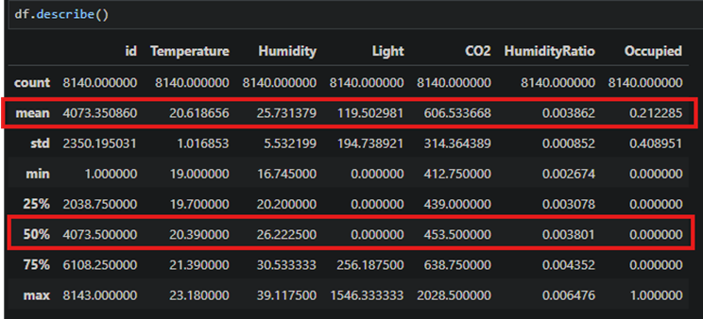
Data Preparation cont.

Slide 5
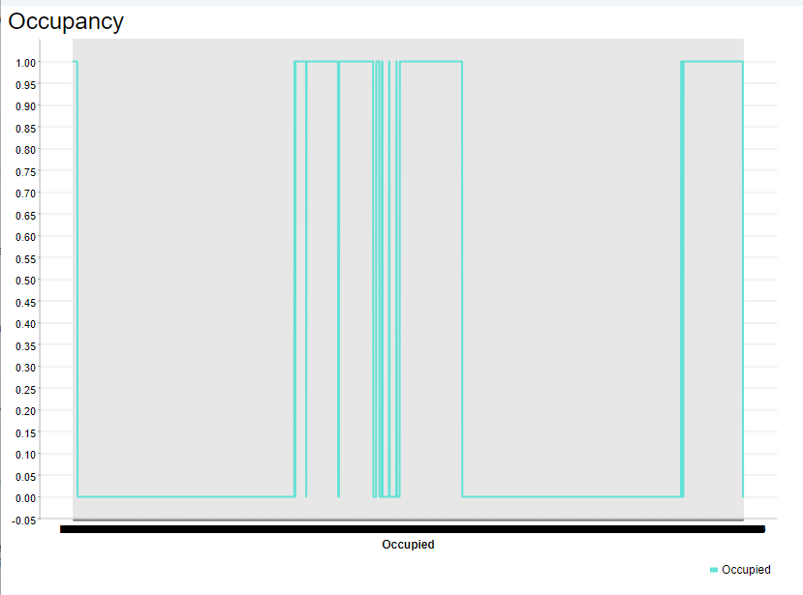
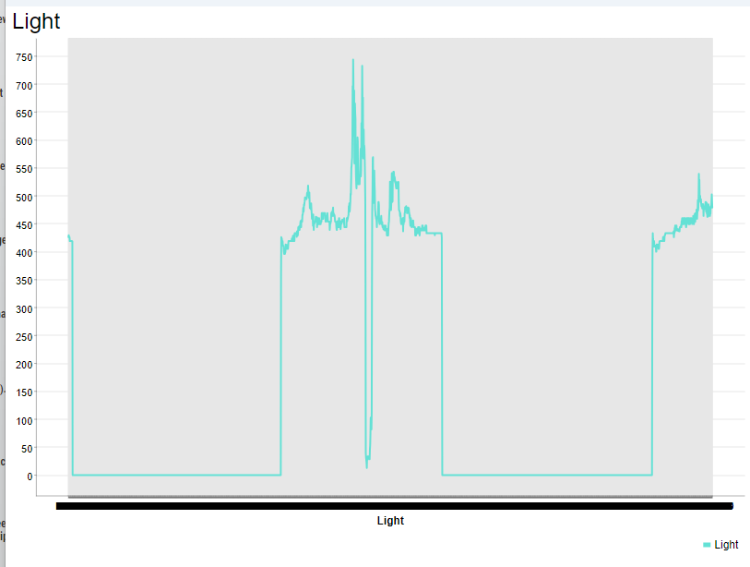
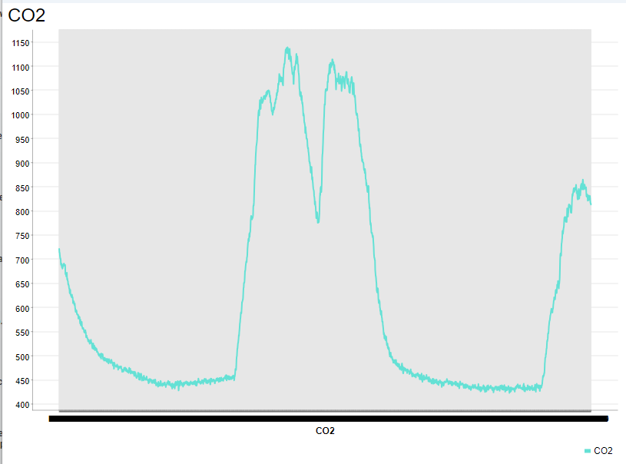
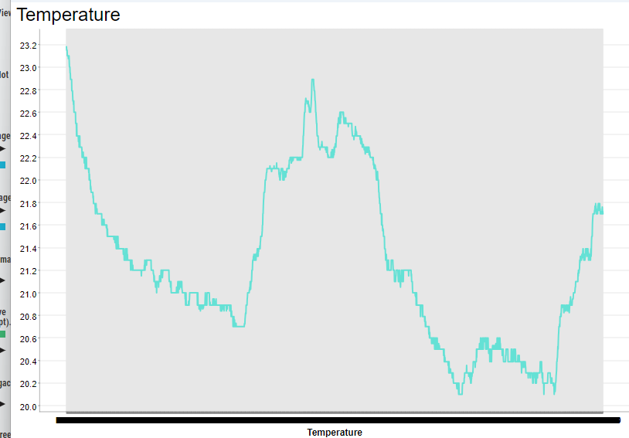
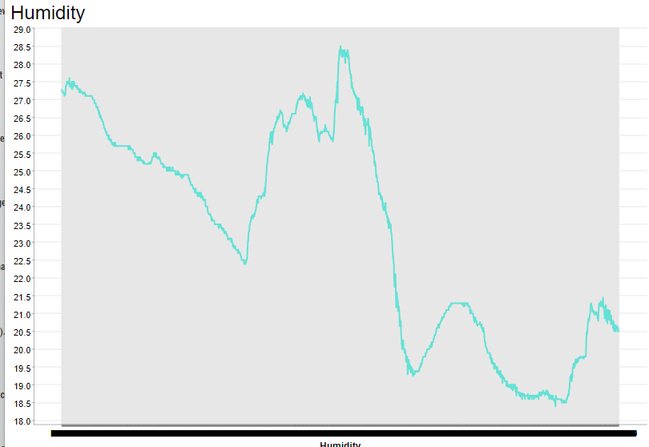
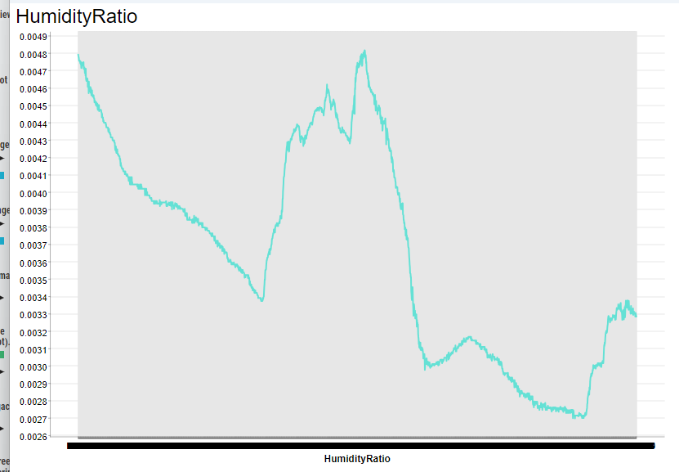
Training Set Exploration
 | Mean | Median
Temperature | 20.61 | 20.39
Humidity | 25.73 | 26.22
Light | 119.50 | 0.0
CO2 | 606.53 | 453.50
HumidityRatio | 0.003862 | 0.003801
KNIME

Slide 6

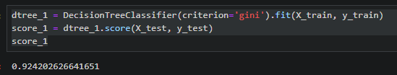
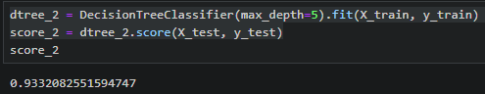
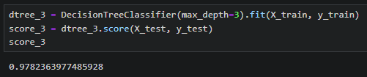
Predicting Occupancy
Parameter: max_depth=5, how much tree can expand
Parameter: criterion=’gini’, decides purest split
Parameter: max_depth=3, how much tree can expand

Slide 7
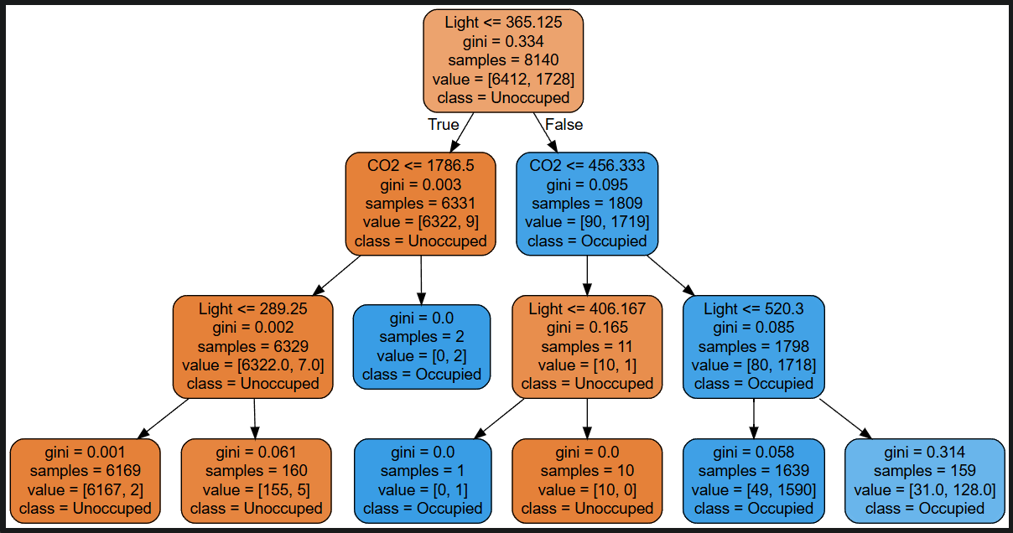
Predicting Occupancy
Model 3 has an accuracy of 98%

Slide 8

Conclusion
Data Preparation
Predicting Occupancy
Training Set Exploration
Final Thoughts

